Slide 1
Used car PRICE PREDICTION
Submitted by –
Krishna Prasad

Slide 2
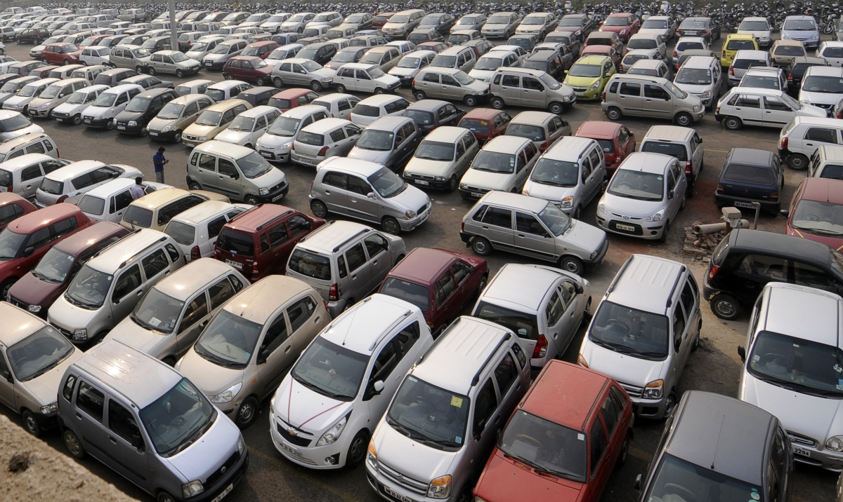

Slide 3
INTRODUCTION
A car is a wheeled motor vehicle used for transportation. Most definitions of cars say that they run primarily on roads, seat one-to-eight people, have four wheels and mainly transport people rather than goods.
Cars came into global use during the 20th century, and developed economies depend on them.
Predicting the price of used cars in both an important and interesting problem.
Sometimes selling your used car becomes crucial as we are not able to identify its fair price accurately. The depreciation of a car depends on a variety of factors so the car owner needs to be aware of the worth of their vehicle. With the rapid expansion of Machine Learning, this problem can also be solved by minimizing human efforts and time.¶
Let’s see an end-to-end solution for a similar problem.

Slide 4
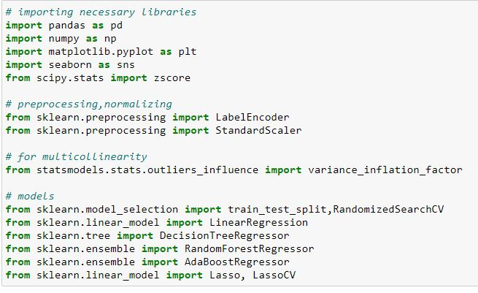
Importing necessaries libraries

Slide 5
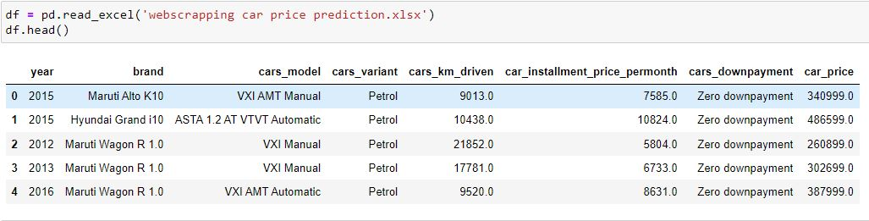
Dataset
1)Excel data

Slide 6

Using shape function after concatenating

Slide 7
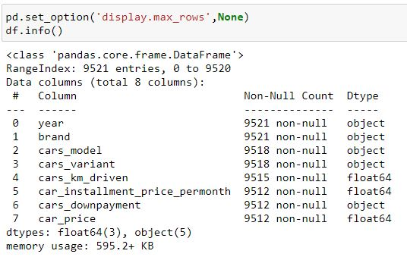
Finding Null Values

Slide 8

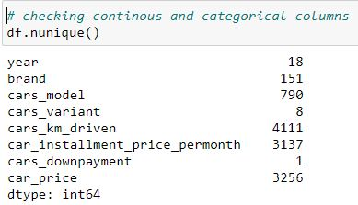
Checking The Duplicates
Checking continuous and categorical columns

Slide 9
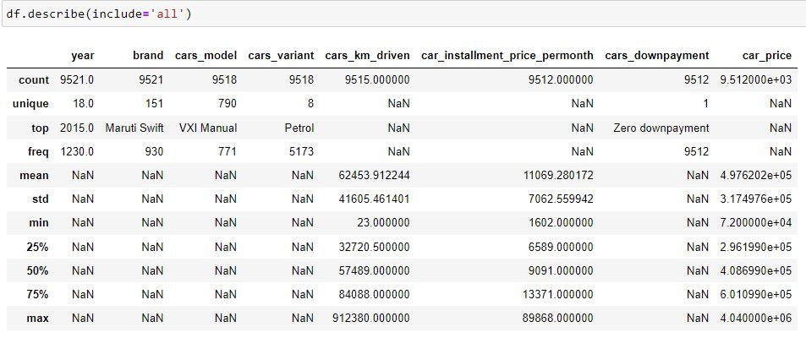
Using Describe

Slide 10
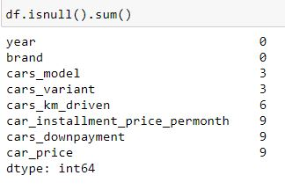

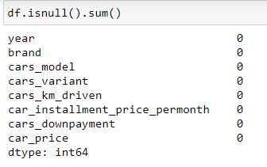
Checking Null Values
Dropping Null Values

Slide 11
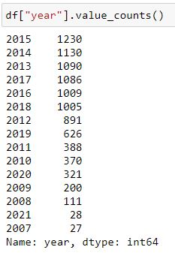
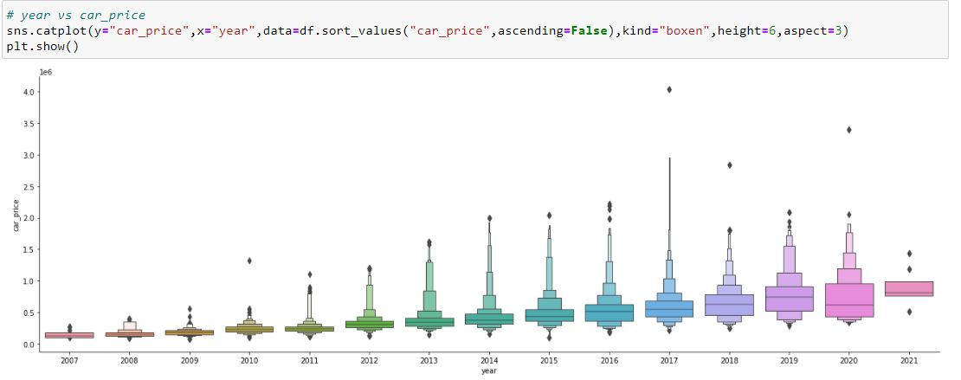
EDA - Exploratory Data Analysis
Using Cat plot
Year vs Price

Slide 12
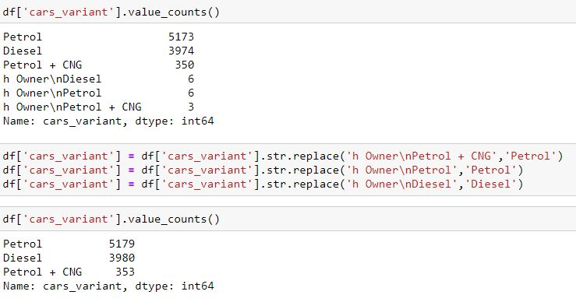
Cars_variant vs Price

Slide 13
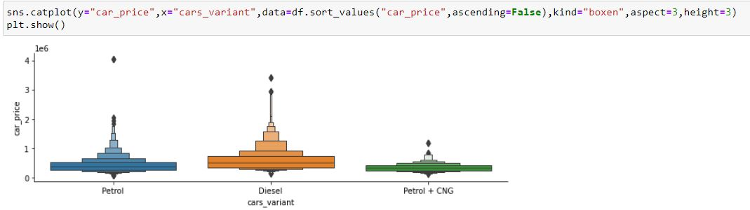

Slide 14

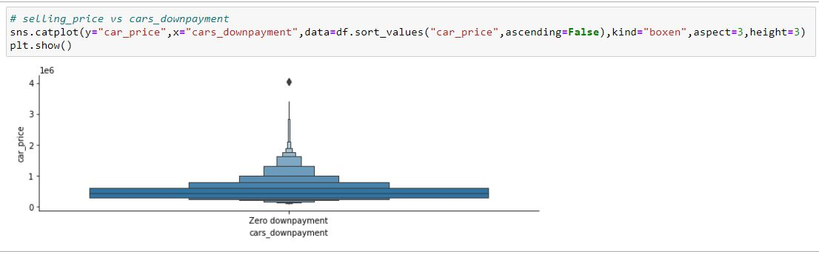
cars_downpayment vs price

Slide 15
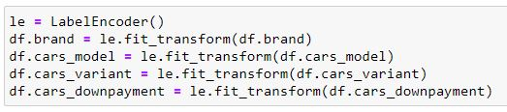
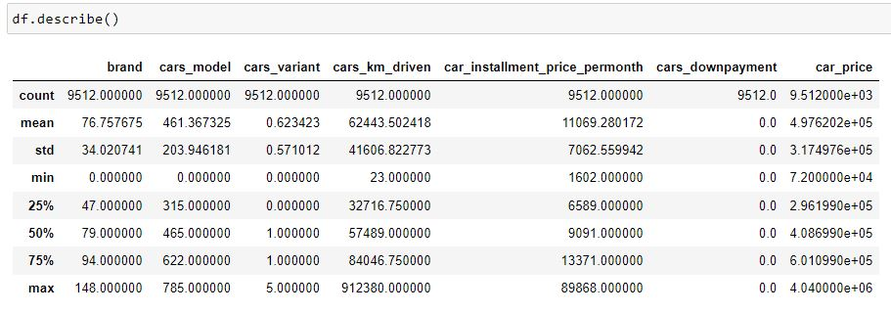
LABEL ENCODER

Slide 16
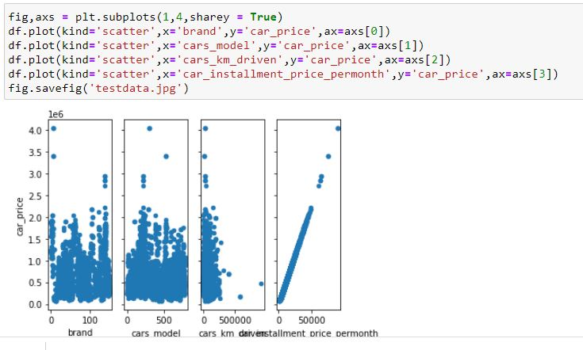
Scatter Plot

Slide 17
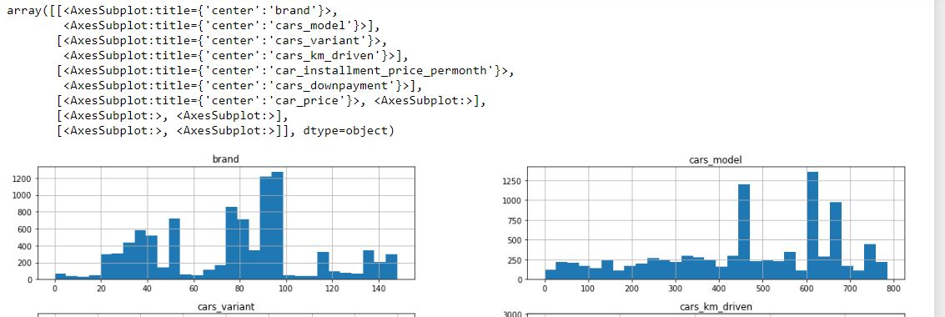
Histogram Plot

Slide 18
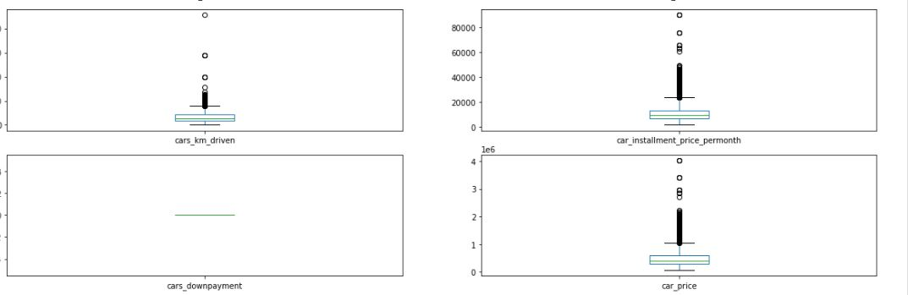
Box Plot

Slide 19
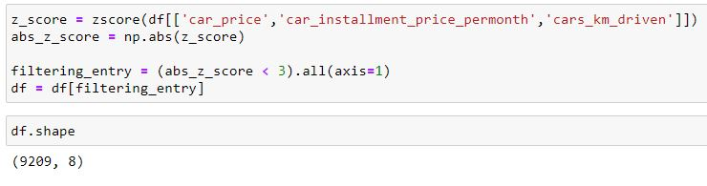
Z Score

Slide 20
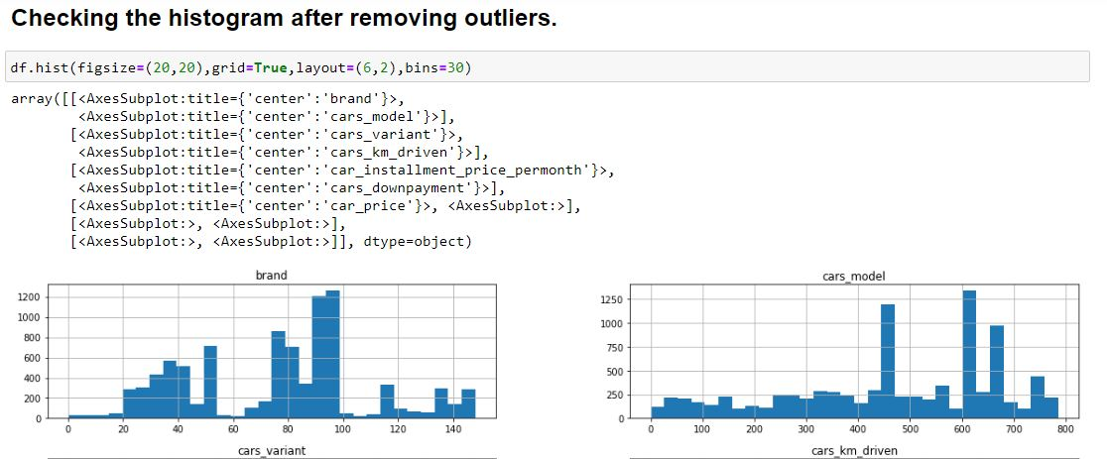
HISTOGRAM plot after removing the outliers & skewness

Slide 21

Machine Learning model building Dividing features and label

Slide 22
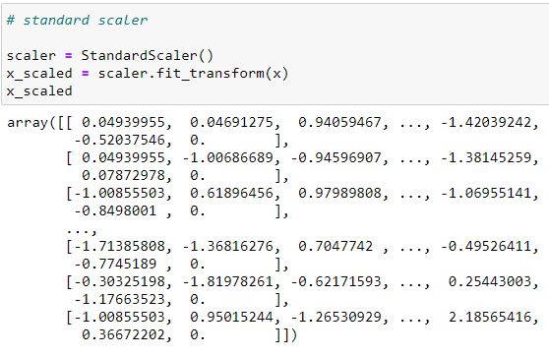
Standard Scaler

Slide 23
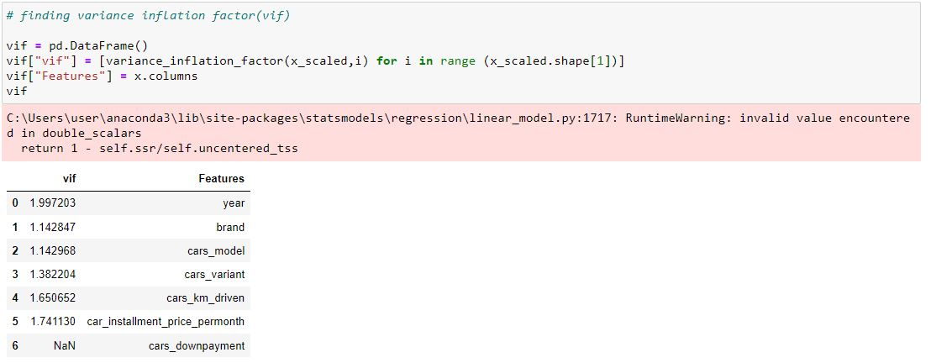
VIF - variance inflation factor

